Slide 1
Information Visualization
Task-03: FINAL project presentation

Slide 2
Group members
Group name: UFC Visualization
Ishwa Obaid (326869)
Rameesha Gull (327317)
Muhammad Shoaib (320124)
Urooj Fatima (329471)

Slide 3
Ultimate UFC Dataset
Dataset contains data of every UFC bout from mid 2010 onwards.
This is a quantitative dataset.
It includes:
the history of UFC fighter rankings.
gambling odds for each fights
The dataset has data of 4567 bouts and 137 features each.
This dataset was taken from Kaggle: https://www.kaggle.com/mdabbert/ultimate-ufc-dataset?select=ufc-master.csv .

Slide 4
What-Why-How Framework
What: Data | Tabular data, quantitative data, rows represent items, columns show attributes, Quantitative attributes and categorical attributes
Why: Tasks | Analyze data, find trends, predict winners, compare bout weights, identify outlier location
How: Encode | Bar chart layout, length shows quantitative attribute, hue represents categorical attribute. Pie chart, size of sector shows quantitative data, hue represents categorical attribute.

Slide 5
Visualization and Interaction
The Data has more then 130 features so we can visualize most import features which are given below.
Bar charts to visualize winners teams for the bout.
Count plot or bar plot to visualize the weight class feature in the dataset.
Pie chart to present numbers of fights in particular locations.

Slide 6
Visualization Libraries
We used python code to make the visualizations for this dataset.
Following libraries were used:
Matplotlib
pyplot
patches
Pandas

Slide 7
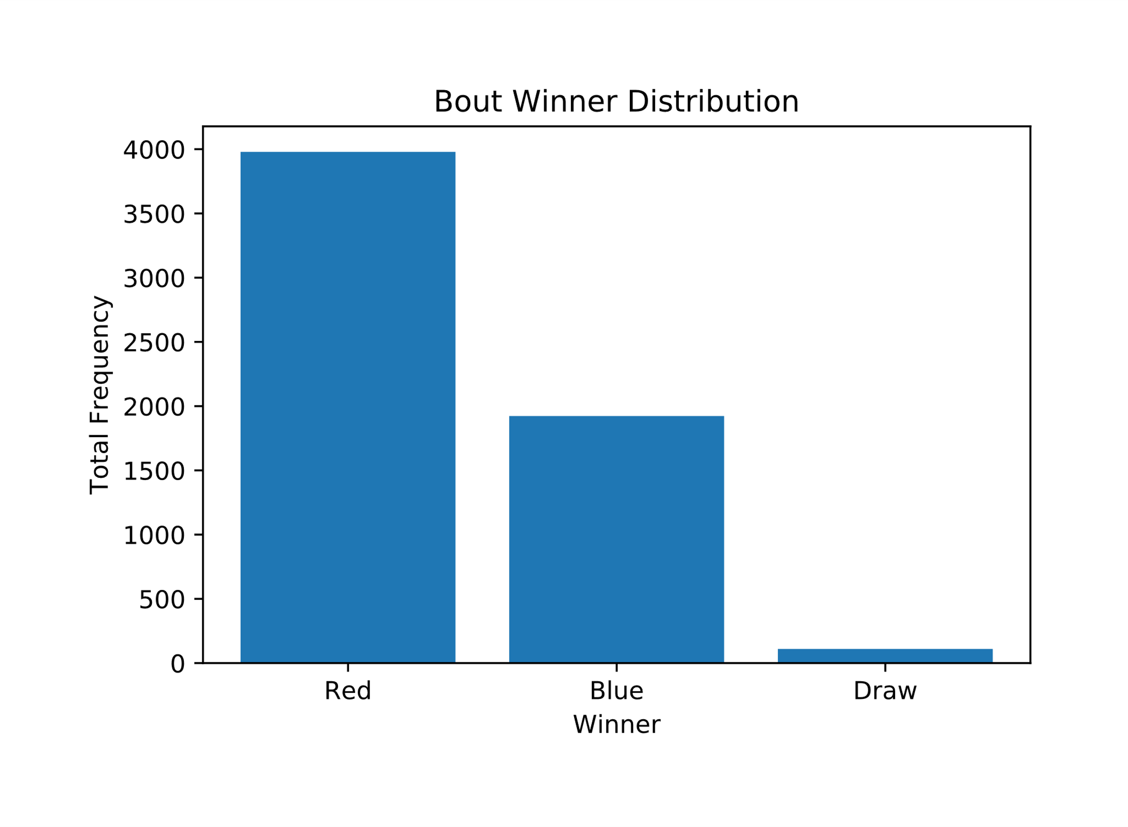
Visualtization-01:
This is a bar graph that shows the overall winners of bouts.
Y-axis shows the number of bouts and X-axis shows the players (Red and Blue team).
The length of the bar indicates the total frequency i.e. number of bout won by a team.

Slide 8
Evaluation:
Clarity:
The purpose of the graph is shown by its title
The axes convey the data being used
The graph is simple and conveys one information i.e. frequency of wins
Grouping by length makes the graph easy to read
Expressiveness:
Magnitude channels (length and horizontal position on aligned scale) are used because data is quantitative and ordinal
Effectiveness:
Position and length are the top most important attributes and they are used first

Slide 9
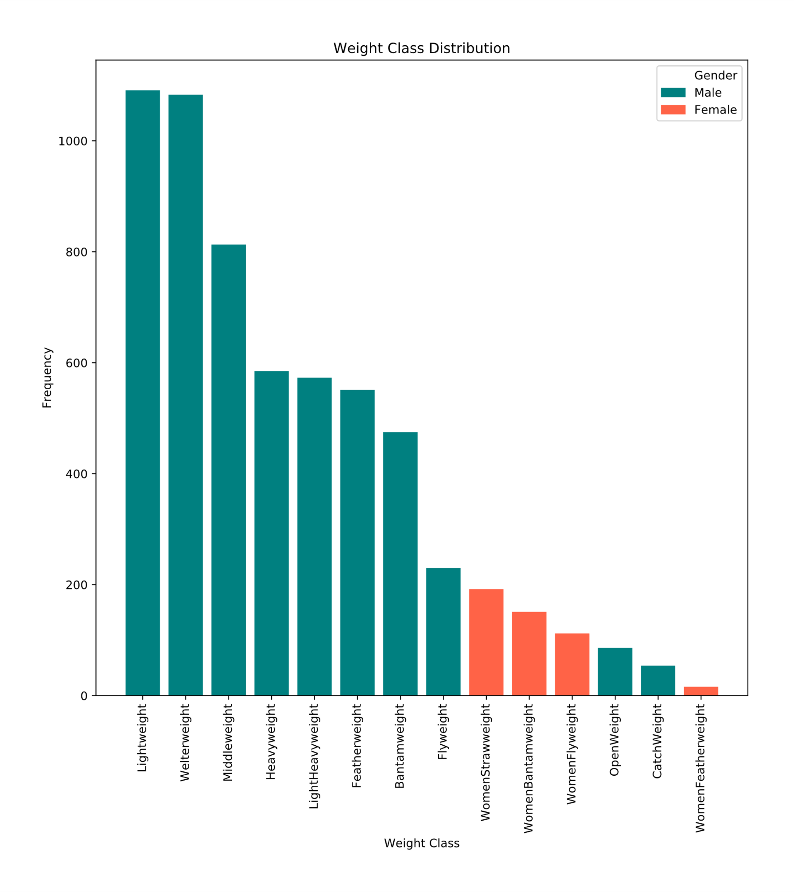
Visualization-02:
This is a bar graph that shows the distribution of players into different weight classes.
The length of the bar represents the number of players in a particular weight class.
The color of the bar represents the gender to which the weight class belongs.

Slide 10
Evaluation:
Clarity:
The purpose of the graph is shown by its title
The axes convey the data being used
The graph is simple and conveys one information i.e. frequency of weight class
Grouping by length adds to the readability of the graph
Expressiveness:
Magnitude channels (length and horizontal position on aligned scale) are used for the quantitative data (frequency)
Identity channel (hue) is used for the categorical data (gender)
Effectiveness:
Position, length, hue are the highest ranked channels

Slide 11
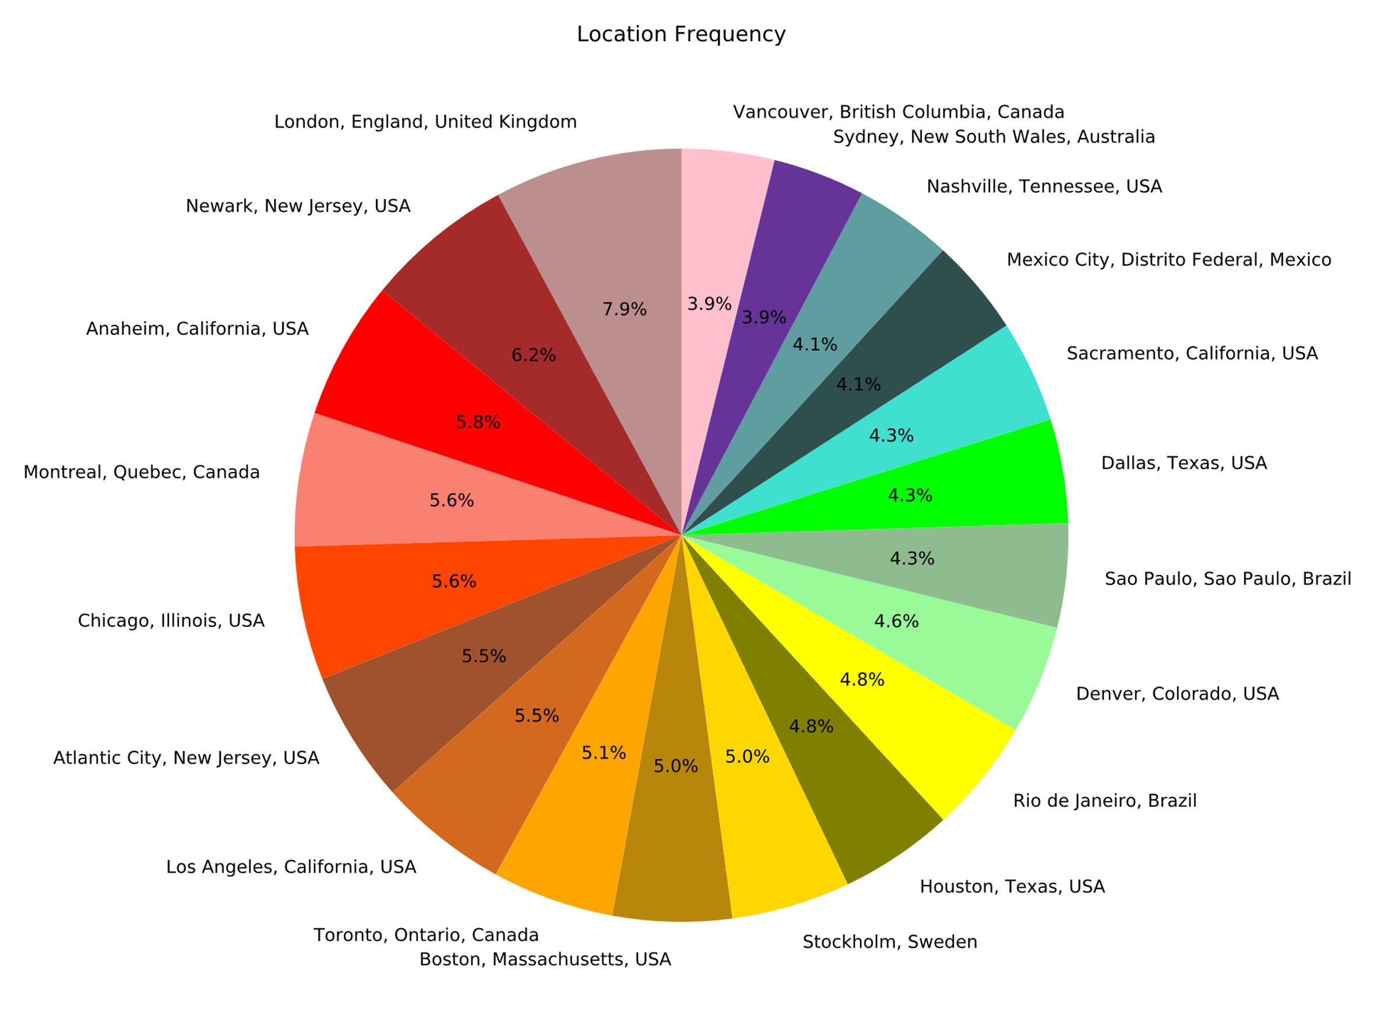
Visualization-03:
This is a pie chart.
It shows the percentage of bouts that took place in a particular location.

Slide 12
Evaluation:
Clarity:
The purpose of the graph is shown by its title
The radial slices convey the data being used
The graph is simple and conveys one information i.e. number of bouts per location
Expressiveness:
Magnitude channel (size of slice) is used for displaying quantitative data
Identity channel (hue) is used for the categorical data (location)
Effectiveness:
Size of radial slice and hue are the highest ranked channel

Slide 13
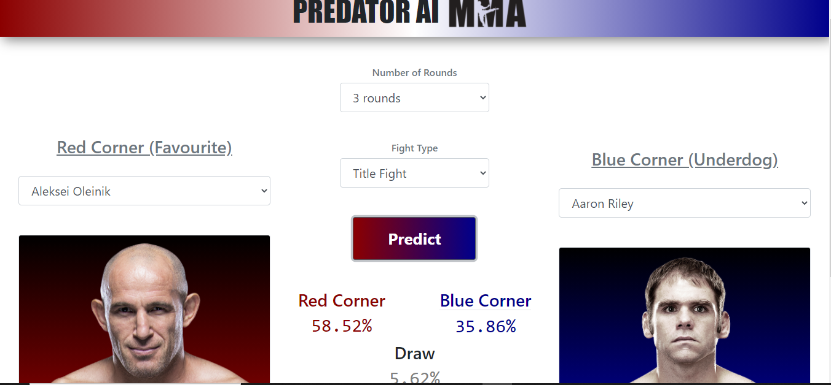
Prediction model:
Xgboost classifier user
Two players are from each team
Winning percentage of red corner and blue corner individually and percentage or draw is shown.

Slide 14
DEMO

Slide 15
Insights
There are 4567 bouts and130+ features each.
Most bouts are won by the red team.
Very less number of bouts have ended in a draw.
There are more male weight classes.
Male weight classes have more number of players.
Most bouts have happened in UK.

Slide 16
Conclusion
The used dataset data of every UFC bout from mid 2010 onwards.
The data can be used to predict the winners, compare players data against,
3 visualizations using Python:
Bar chart to show number of bouts won by a team.
Bar chart to show shows the distribution of players into different weight classes.
Pie chart to show the number of bouts that took place in a particular location.

Slide 17
Work Breakdown
Group member | Tasks performed
Ishwa Obaid | Presentation, Report, Visualization
Rameesha Gull | Presentation, Report
Muhammad Shoaib | Report, Visualizations, GitHub Repository
Urooj Fatima | Presentation, Report

Slide 18
THANK YOU!
ANY QUESTIONS?

